Slide 1
Demo on building and deploying an application in Openshift which is redhat PAAS offering
Our application is a telephone directory which displays username/country and phone number .
Application has 2 parts
1) Web app built using Python and Flask framework
2)MYSQL database which holds user data that is being used by webapp
MYSQL
DATABASE
WEBAPP

Slide 2
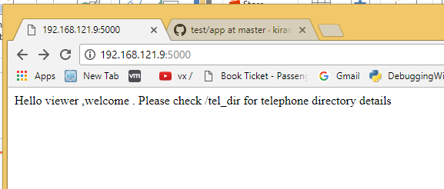
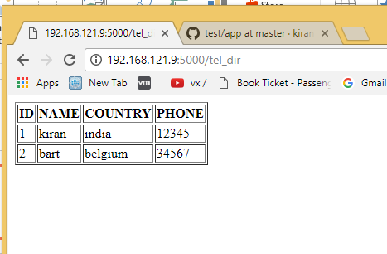
Pages displayed by the app
First page is a Welcome page with information
Second page is displaying details accessed from a mysql database

Slide 3
PHYSICAL MACHINE
USER SPACE
APP1
APP2
DB1
KERNEL SPACE
HARDWARE (CPU/RAM/DISK)

Slide 4
PHYSICAL MACHINE
USER SPACE
Security ,as one app can access other app files
If a reboot is needed for one app ,it impacts
other apps
3) If same port is needed by by both apps
….
…
…
APP1
APP2
DB1
KERNEL SPACE
HARDWARE (CPU/RAM/DISK)

Slide 5
TRADITIONAL
VIRTUALIZATION
CONTAINERIZATION
PHYSICAL MACHINE
PHYSICAL MACHINE
PHYSICAL MACHINE
USER SPACE
VIRTUAL MACHINE
VIRTUAL MACHINE
CONTAINER
CONTAINER
USER SPACE
USER SPACE
APP1
APP2
APP1
APP2
DB1
USER SPACE
USER SPACE
APP1
APP2
KERNEL SPACE
KERNEL SPACE
VIRTUAL H/W
VIRTUAL H/W
KERNEL SPACE
HYPERVISOR KERNEL
KERNEL SPACE
HARDWARE (CPU/RAM/DISK)
HARDWARE (CPU/RAM/DISK)
HARDWARE (CPU/RAM/DISK)

Slide 6
CONTAINERS WITH IN VIRTUAL MACHINES
PHYSICAL MACHINE
VIRTAUL MACHINE
VIRTAUL MACHINE
CONTAINER
CONTAINER
CONTAINER
CONTAINER
USER SPACE
USER SPACE
USER SPACE
USER SPACE
APP1
APP2
APP3
APP4
KERNEL SPACE
KERNEL SPACE
VIRTUAL HARDWARE (CPU/RAM/DISK)
VIRTUAL HARDWARE (CPU/RAM/DISK)
HYPERVISOR KERNEL
HARDWARE (CPU/RAM/DISK)

Slide 7
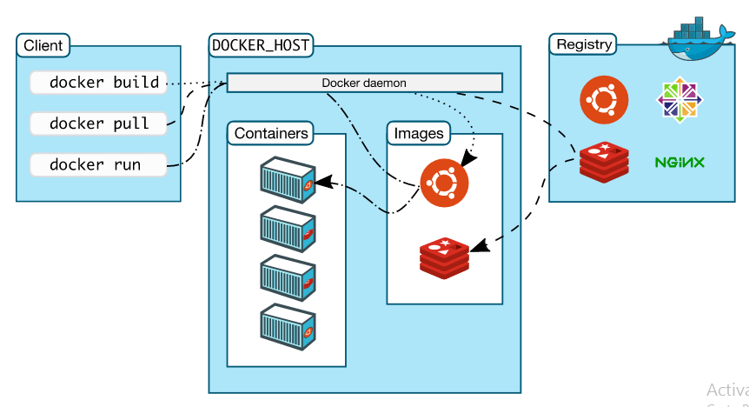

Slide 8
CONTAINER
CONTAINER
DOCKER
USER SPACE
USER SPACE
APP1
APP2
KERNEL SPACE
HARDWARE (CPU/RAM/DISK)

Slide 9
Demo is consisting of 3 parts
Part 1: Deploy application on a Machine
Part 2 :Deploy application with in Containers
Part 3: Deploy application with in Openshift

Slide 10
Part 1: Deploy application on a Machine
Setup Details
→Centos 7 VM ,running on Oracle virtualbox
→Software’s required to be installed are python,flask, flask_mysqldb,mysql,mysql-server,git
Application can be depicted as below
CENTOS 7 VM/ IP_ADDR = 192.168.121.9
WEB-APP
MYSQL DB

Slide 11
Upload data to the database :
Mysql server should already be running , connect to the database as below , then create table and upload data
mysql -u root –p
CREATE DATABASE tel_dir;
use tel_dir;
CREATE TABLE details( id INT NOT NULL AUTO_INCREMENT,
name VARCHAR(100) NOT NULL,
country VARCHAR(40) NOT NULL,
phone INT NOT NULL,
PRIMARY KEY(id));
use tel_dir;
INSERT INTO details
(id,name,country,phone)
VALUES
(1,"kiran","india",12345);
INSERT INTO details
(name,country,phone)
VALUES
("bart","belgium",34567);

Slide 12
Download application code from github as below
# git clone https://github.com/kiranpampana/kiran-app.git
Running above would download code to directory kiran-app, go to directory kiran-app/app and check the code in app.py
# cd kiran-app/app
# cat app.py
Now run the application as below
# python app.py localhost
Connect to web browser and check both the links below, ensure no firewalls are blocking
(ip address of my centos7 vm is 192.168.121.9 , you have to use the ip of your VM)
http://192.168.121.9:5000
http://192.168.121.9:5000/tel_dir

Slide 13
Part 2 :Deploy application with in Containers
Setup Details
→Centos 7 VM ,running on Oracle virtualbox (same as the earlier one)
→Software’s required to be installed and started are docker
Application can be depicted as below
CENTOS 7 VM /(IP_ADDR = 192.168.121.9)
DOCKER
APP
CONTAINER
DB
CONTAINER

Slide 14
Start database container as below
# docker run -itd --name db -e MYSQL_ROOT_PASSWORD=password mysql
Connect to container
# docker exec –it db bash
Connect to database and upload data as below
mysql -u root –p
CREATE DATABASE tel_dir;
use tel_dir;
CREATE TABLE details( id INT NOT NULL AUTO_INCREMENT,
name VARCHAR(100) NOT NULL,
country VARCHAR(40) NOT NULL,
phone INT NOT NULL,
PRIMARY KEY(id));
use tel_dir;
INSERT INTO details
(id,name,country,phone)
VALUES
(1,"kiran","india",12345);
INSERT INTO details
(name,country,phone)
VALUES
("bart","belgium",34567);

Slide 15
Go to directory having earlier downloaded kiran-app git repository ,it should have Dockerfile ,verify that file
# cd ~/kiran-app
# cat Dockerfile
Build the docker image as below using Dockerfile
# docker build -t kiranpampana/kiran-app .
Upload the docker image having the app to the dockerhub for later use
# docker login
# docker push kiranpampana/kiran-app
Start the app container using IP of db container as below
#docker inspect db |grep "IPAddress"
"SecondaryIPAddresses": null,
"IPAddress": "172.17.0.2",
# docker run -itd -p 63317:5000 --name app -e MYSQL_HOST=172.17.0.2 kiranpampana/kiran-app
Connect to web browser and check both the links below, ensure no firewalls are blocking
(ip address of my centos7 vm is 192.168.121.9 , you have to use the ip of your VM)
http://192.168.121.9:63317
http://192.168.121.9:63317/tel_dir

Slide 16
Part 3 : Deploy application in openshift
Setup Details
→Openshift Origin 1.5.1 installed on centos 7 machines (google cloud)
→Openshift cluster has 1 master and 2 minion nodes.
Openshift cluster
o-master
o-node1
o-node2

Slide 17

Application in openshift can be depicted as below
Pod → Pod is a group of ONE or more containers
Internet
route
(HA PROXY/LOAD BALANCER)
service
(Internal proxy/load balancer)
Pod1
Pod2

Slide 18
Login into o-master and download git as below
# git clone https://github.com/kiranpampana/kiran-app.git
Running above would download code to directory kiran-app, go to directory kiran-app/ and check , you should various yaml files
We shall deploy the app now
Check kiran-app.yaml file and try to understand its contents
Lets deploy application as below
# oc create -f kiran-app.yaml
Check using below commands, pod with kiran-app should have been created
# oc get pods
We shall create the service now for the app
Check kiran-svc.yaml file and try to understand its contents
Let create the services as below
# oc create -f kiran-svc.yaml
Check using below commands , new service with name kiran-app should have been created
# oc get svc

Slide 19
We shall create a route for the kiran-app service as below
#oc expose svc kiran-app
Check the new route created as below
# oc get route
Use the route obtained above to access the app , for my case its
http://kiran-app-my-test.apps.kiran-pampana.tk
Try to access http://kiran-app-my-test.apps.kiran-pampana.tk/tel_dir ,it should through error because db is not yet created

Slide 20
Route→ kiran-app-my-test.apps.kiran-pampana.tk
(oc expose svc kiran-app)
Service→ kiran-app
(oc create –f kiran-svc.yaml)
Mysql db
Pod→ kiran-app****
(oc create –f kiran-app.yaml)

Slide 21
We shall deploy the db now
Check mysql-db.yaml file and try to understand its contents
Lets deploy application as below
# oc create -f mysql-db.yaml
Check using below commands, pod with mysql-** should have been created
# oc get pods
We shall create the service now for the app
Check mysql-svc.yaml file and try to understand its contents
Let create the services as below
# oc create -f mysql-svc.yaml
Check using below commands , new service with name mysql should have been created
# oc get svc

Slide 22
Connect to the mysql pod as below
# oc rsh mysql-***
Connect to database and upload data as below
mysql -u root –p
CREATE DATABASE tel_dir;
use tel_dir;
CREATE TABLE details( id INT NOT NULL AUTO_INCREMENT,
name VARCHAR(100) NOT NULL,
country VARCHAR(40) NOT NULL,
phone INT NOT NULL,
PRIMARY KEY(id));
use tel_dir;
INSERT INTO details
(id,name,country,phone)
VALUES
(1,"kiran","india",12345);
INSERT INTO details
(name,country,phone)
VALUES
("bart","belgium",34567);

Slide 23
Try to access http://kiran-app-my-test.apps.kiran-pampana.tk/tel_dir ,it should work
Route→ kiran-app-my-test.apps.kiran-pampana.tk
(oc expose svc kiran-app)
Pod→ mysql-****
(oc create –f mysql-db.yaml)
Service→ kiran-app
(oc create –f kiran-svc.yaml)
Pod→ kiran-app****
(oc create –f kiran-app.yaml)
Service→ mysql
(oc create –f mysql-svc.yaml)

Slide 24
Thank you

